Slide 1
Non Hydrocarbon INTERMEDIATES
SYNTHESIS GAS
NAPHTHENIC ACIDS
CRESYLIC ACIDS

Slide 2
Botwe Harriet Nana Ama
Batubo Gogo Henry
Bedzo Oscar
Boakye Daniel

Slide 3
OVERVIEW
Non hydrocarbon intermediates are the products that occur in natural gases, crude oils and other fossil materials such as coal that are not hydrocarbon compounds.
In many cases they have noxious or have harmful effects and must be removed or converted to less harmful compounds during the refining process.
Examples of hydrocarbon intermediates include:
Synthesis gas
Naphthenic acids
Cresylic acids

Slide 4
SYNTHESIS GAS
INTRODUCTION
Synthesis (Syngas) is the name given to gases comprising of carbon monoxide and hydrogen.
Process in many countries have been abandoned due to high cost of production but this process is still under use in South Africa where coal is inexpensive.
Sources for of synthesis gas include methane (natural gas), heavy petroleum residues and coal.

Slide 5
PRODUCTION OF SYNTHESIS GAS
Coal Gasification
Steam reforming
Petroleum products
Steam reforming natural gas
Synthesis Gas
(CO, H₂ mixture)
Partial oxidation of natural gas and petroleum products
The different sources and routes to synthesis gas.

Slide 6
STEAM REFORMING OF NATURAL GAS
A major route for producing synthesis gas is the
steam reforming of natural gas over a promoted
nickel catalyst at about 800°C:
CH₄(g) + H₂O(g) CO(g) + 3H₂(g)
This route is most favorable when natural gas is
abundant and inexpensive, hence is mostly used
in countries like Saudi Arabia and the USA.

Slide 7
STEAM REFORMING OF PETROLEUM PRODUCTS
Synthesis gas is also produced by steam reforming of naphtha.
An example of steam reforming may be represented using n-heptane.
CH₃ (CH₂) ₅CH₃+ 7H₂O(g) 7CO(g) + 15H₂(g)
As the molecular weight of the hydrocarbon increases (lower H/C feed ratio), the H₂/CO product ratio decreases. The H₂/CO product ratio is approximately 3 for methane, 2.5 for ethane, 2.1 for heptane, and less than 2 for heavier hydrocarbons.

Slide 8
PARTIAL OXIDATION OF NATURAL GAS AND PETROLEUM PRODUCTS
Non-catalytic partial oxidation of hydrocarbons is also produce synthesis gas, but the H₂/CO ratio is lower than from steam reforming:
CH₄(g) + 1/2O₂ (g) CO (g) + 2H₂ (g)
In practice, this ratio is even because part of the methane is oxidized to carbon dioxide and water

Slide 9
GASIFICATION OF COAL
The gasification process is used to convert any material that has carbon to a ‘syngas’ .
This is inserted to the gasifier in dry or slurry form. In the gasifier, this feedstock reacts in an oxygen starved environment with steam and oxygen at elevated pressure and temperature. In this way, syngas is manufactured.
The syngas so produced may contain some trace elements of impurities which are removed recovered or redirected to the gasifier.

Slide 10
Gasifier
Particulates/
Ash
Gaseous
constituents
Coal
Syn gas
CO/H₂
Resids
Sulfur/Sulfuric Acid
Oxygen
Solids
Steam
Phenol Tar

Slide 11
USES
Can be burnt and used as a fuel source.
As feed stock for chemical synthesis through conversion to methanol..
It can be used to produce synthetic fuels using the Fischer Tropsch process.

Slide 12

NAPHTHENIC ACIDS

Slide 13
INTRODUCTION:
Naphthenic acids are a mixture of cyclo-paraffins with alkyl side chains ending with a carboxylic group.
The low-molecular-weight naphthenic acids (8–12 carbons) have either a cyclopentane or a cyclohexane ring.
These compounds are normally found in middle distillates.
Naphthenic acids constitute about 50 wt% of the total acidic compounds in crude oils.
Crude oils with high naphthenic content have high TAN.

Slide 14
TYPES:
TYPE A: Used to produce driers
TYPE B: Used to produce inhibitors and emulsifiers
PROPERTIES:
TEST | TYPE A | TYPE B
Density (d₄²⁰) | 0.972 | 0.987
Viscosity SU/210, °F | 40.1 | 159.0
Pour point, °F | -30 | 40
Refractive index (d₄²⁰) | 1.476 | 1.503
Average molecular weight of deoiled acids | 206 | 330
Unsaponifiable matter (wt%) | 12.5 | 6.3
Acid number, mg KOH/g | 235 | _

Slide 15
EXTRACTION:
The production of naphthenic acids from middle distillates occurs by extraction with 7–10% caustic solution.
The formed sodium salts, which are soluble in the lower aqueous layer, are separated from the hydrocarbon layer.
The free acids are then dried and distilled.

Slide 16
REACTION
(CH₂)_{n}COOH
(CH₂)_{n}COONa
+ NaOH
+ H₂O
Naphthenic acid
Sodium naphthenate

Slide 17
USES
The sodium salts are emulsifying agents for preparing agricultural insecticide
Calcium naphthenate is a lubricating oil additive.
Zinc naphthenate is an antioxidant.
Lead, zinc, and barium naphthenates are wetting agents used as dispersion agents for paints.
Some oil soluble metal naphthenates, such as those of zinc, cobalt, and lead, are used as driers in oil-based paints.

Slide 18
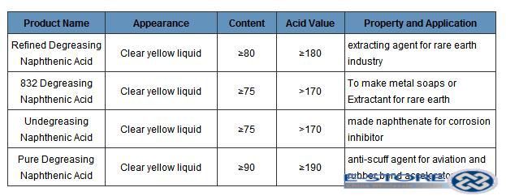
SERIES OF NAPHTHENIC ACIDS

Slide 19
Cresylic Acid
Compositions: Phenol, cresols, xylenol
PROCESS OF EXTRACTION
Obtained from caustic waste streams from treating light distillate with caustic solution to reduce hydrogen sulphide and mercaptan
Obtained from petroleum fraction : Cracked gasoline and coal liquids
Cresols + NaOH Cresylate

Slide 20
Oxidation of mercaptans
Separation of Cresylate solution by decantation
Free cresylate acid is obtained with dilute sulphuric acid

Slide 21
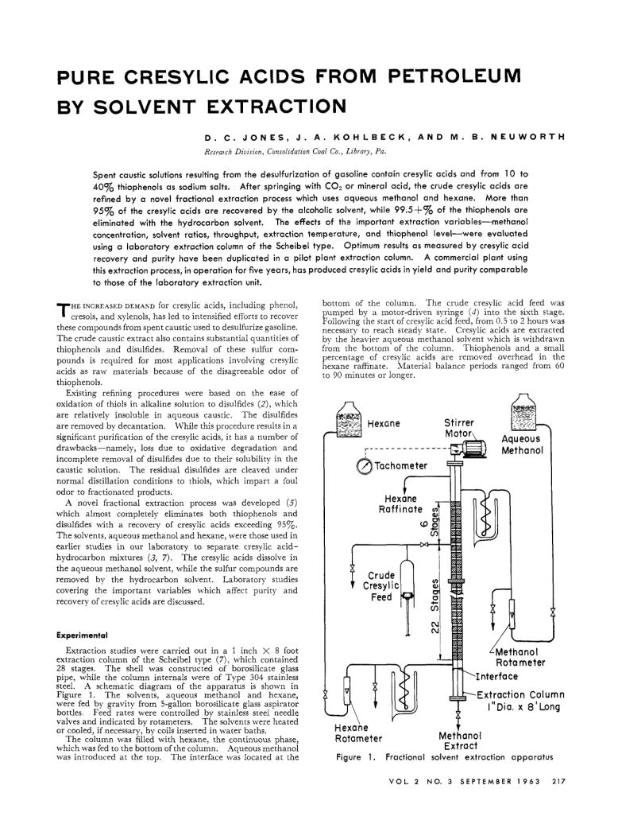

Slide 22
USES
Degreasing agent
Disinfectant
Stabilize emulsion in soap
Wire enamel solvent
Reduction of carbon deposits in combustion chamber

